Slide 1
Graffiti
Keith Haring

Slide 2
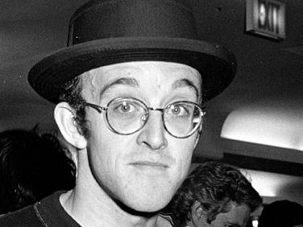
Keith Haring
Keith Allen Haring was an American artist and social activist whose work responded to the New York City street culture of the 1980s by expressing concepts of birth, death, sexuality, and war through graffiti.
Born: May 4, 1958
Died: February 16, 1990

Slide 3
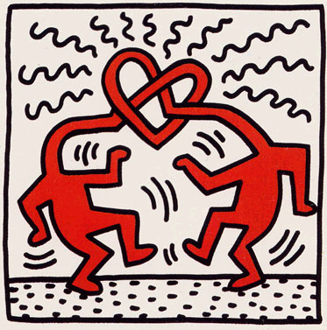
Keith Haring
Drawing with Line

Slide 4
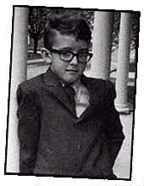
Keith Haring was born May 4, 1958 in Kuztown Pennsylvania

Slide 5
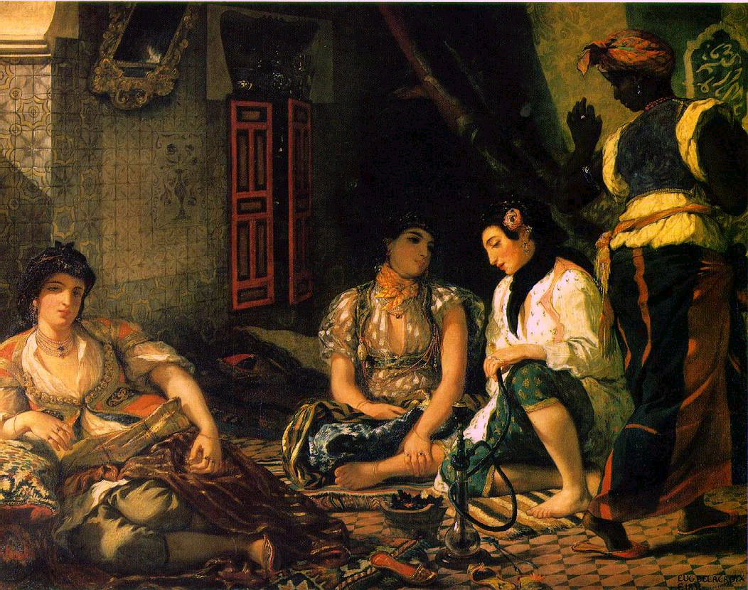
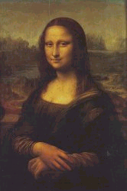
Growing up he wasn’t interested in most of the art he saw at the galleries.
Too Formal!
BORING
He wasn’t interested in creating the art either because he thought it was too formal.

Slide 6
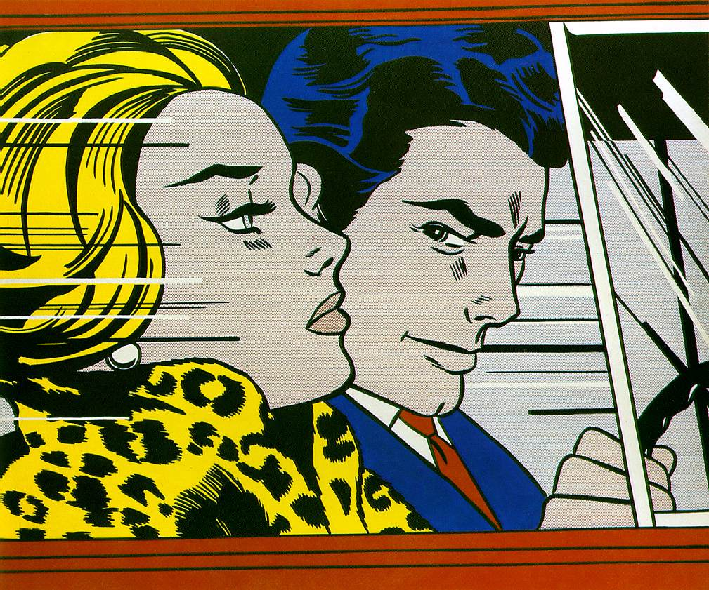
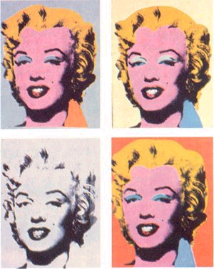
Keith was more interested in the art of the pop artists like Andy Warhol and Roy Lichtenstein who were considered unconventional artists in the art world.
Their works were shaped by television commercials, cartoons, comic strips and advertisements.

Slide 7
Keith first attended college at the Pittsburgh Center for the Arts but in 1978 at the age of twenty he left Pittsburgh for the School of Visual Arts in New York City.
Keith didn’t like the School of Visual Arts either and it wasn’t long before he began to skip classes and then stop going all together.
He continued to live in NYC but was extremely poor and had to take the subway in order to go anyplace.
Public Service Announcement
STAY IN SCHOOL!!!

Slide 8
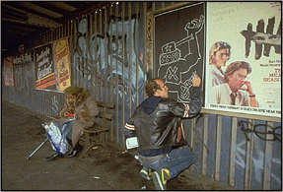
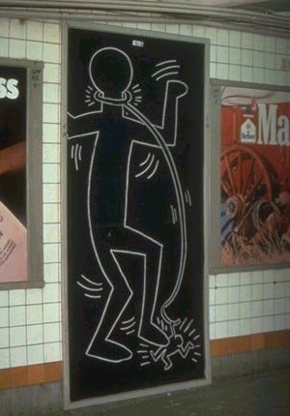
The Subway Artist
During the 1980’s Keith began his career in art in the NYC subway station.

Slide 9
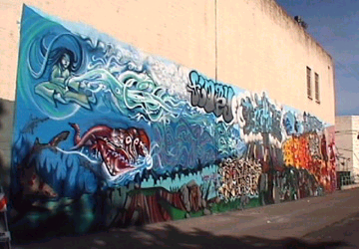
This type of art was called Graffiti Art
Keith was inspired by the graffiti art he saw around him in NYC.

Slide 10
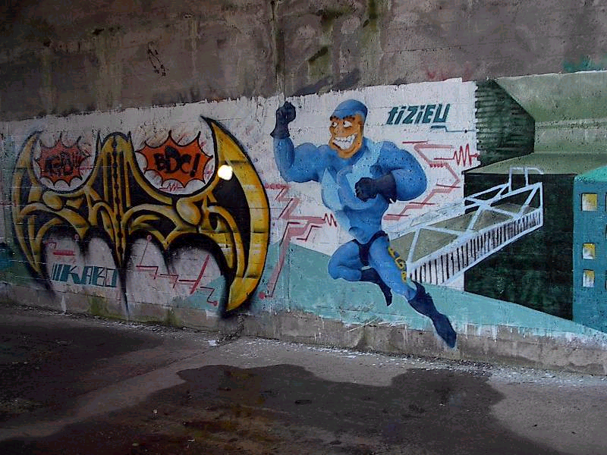
Positive aspects of Graffiti art
Spontaneous
Creative
Is seen by everyone

Slide 11
Negative aspects of Graffiti art:
Uncontrolled graffiti can be destructive
Most of the time it’s illegal

Slide 12
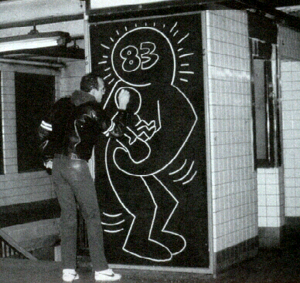
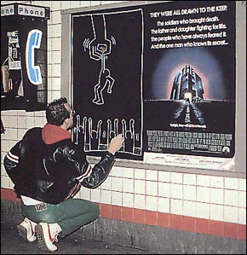
Haring was careful to draw on black paper panels which were going to be covered. He also used chalk because it was easily removable.

Slide 13
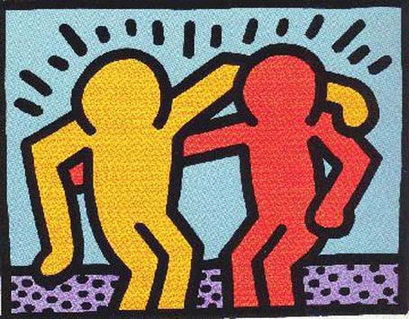
Characteristics of his drawings:
Bold lines
Figures surrounded by rhythmic lines that make them appear to vibrate or move.
Simplified and stylized figures

Slide 14
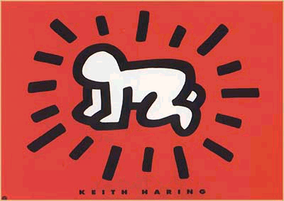
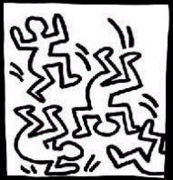
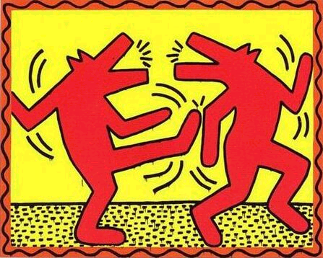
Characteristics of his drawings:
Radiating Baby
Dancing People
Dogs
Flying Saucers

Slide 15
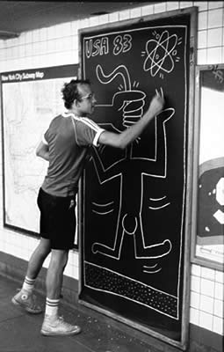
Haring’s work appealed to many different types of people.
Brought a human touch to the dingy and dirty subway stations.
Images were whimsical, often humorous, and somewhat mysterious.
Instead of looking like typical graffiti art, his poster size drawings looked like they were supposed to be there.

Slide 16
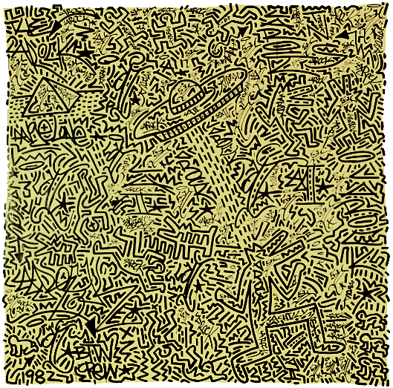
Keith Haring created his own visual language. His symbols appear repeatedly in different artworks of his. This type of pictorial writing system is known
as pictographs.
Pyramid
Figures
Radiating Baby
Spaceship
Dog

Slide 17
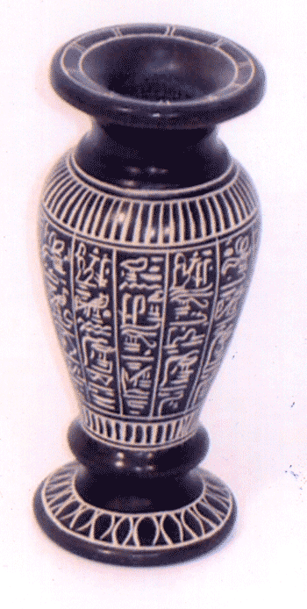
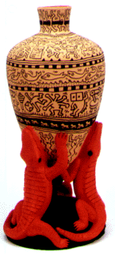
Egyptian
Haring
Like the pictographs of Egyptian hieroglyphics, Haring’s symbols changed meaning depending on what they were placed next to. The study of Haring’s symbols is called semiotics.

Slide 18
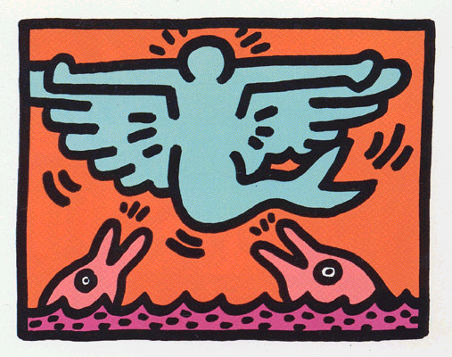
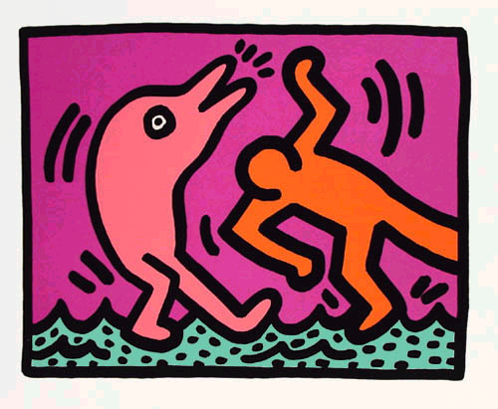
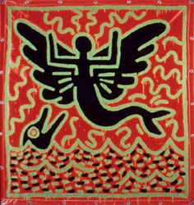
Dolphins Symbolize peace and love

Slide 19
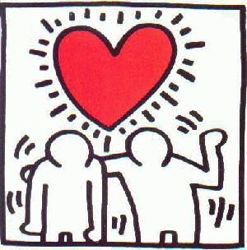
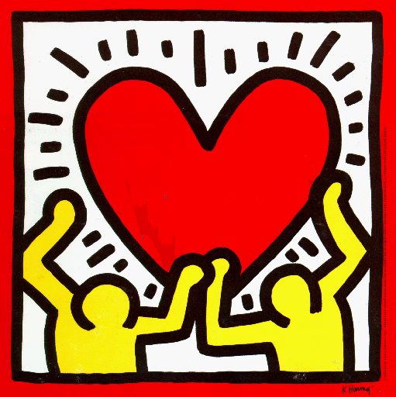
Two humans holding a heart means romantic love

Slide 20
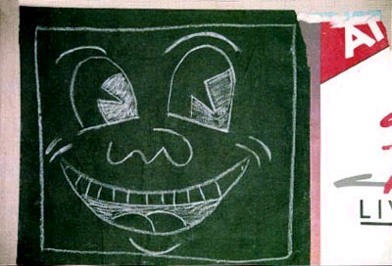
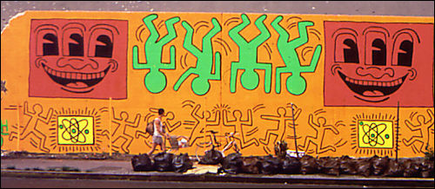
Three-eyed smiling face means greed or joy

Slide 21
Haring’s work began as simple white on black figures but soon he developed into complex compositions crammed with dancing, pulsating figures.

Slide 22
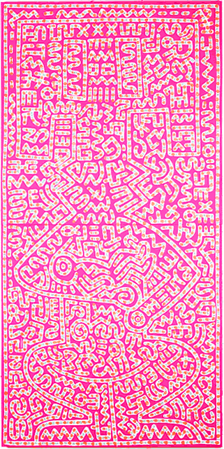
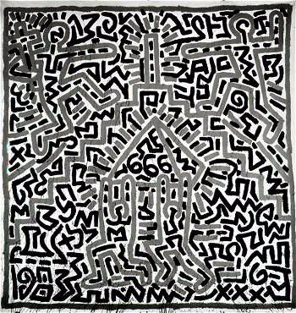
He repeated figures in rhythmic patterns so the pattern itself became more predominant than anyone figure.

Slide 23
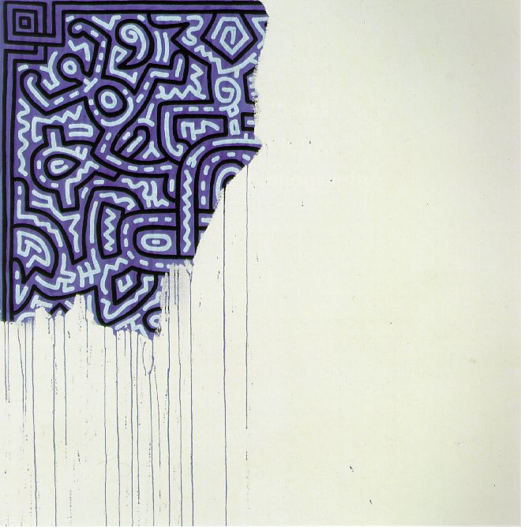

Slide 24
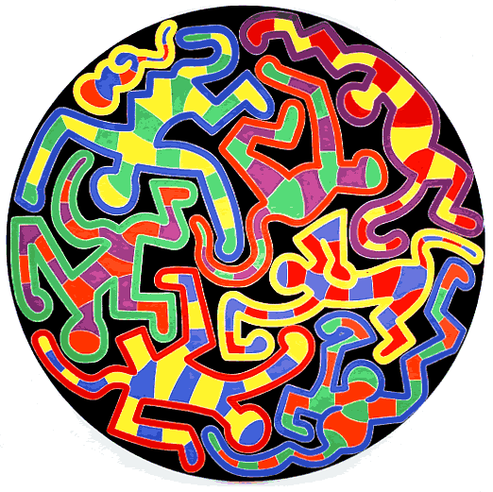

Slide 25
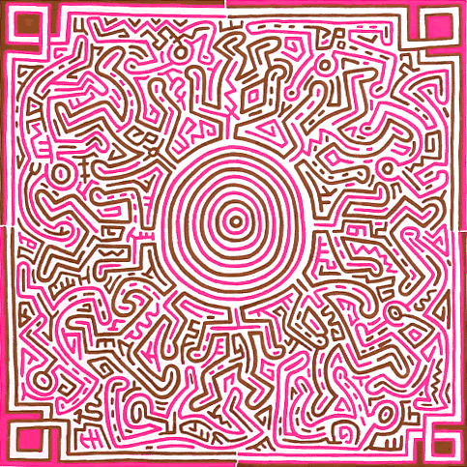

Slide 26
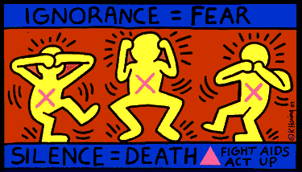
Haring was also well known for being an artist that created art work relating to social and political causes.

Slide 27
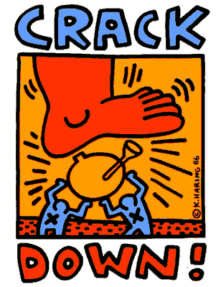
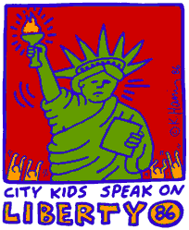

Slide 28
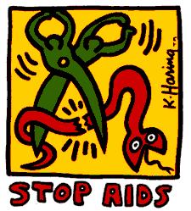

Slide 29
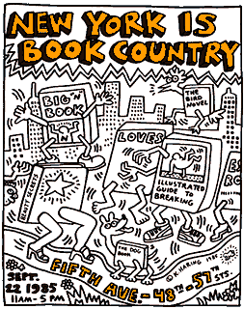
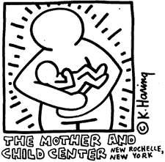

Slide 30
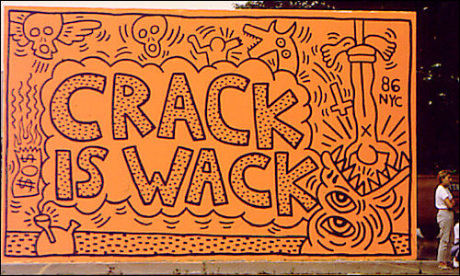
“Crack is Wack” was created after one of his studio assistants became addicted to crack.

Slide 31
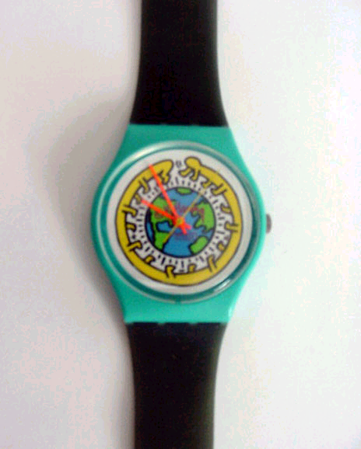
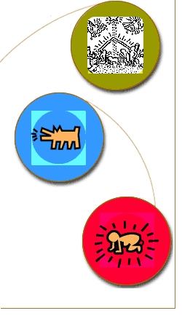
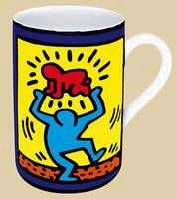
As Haring became famous his artworks became increasingly more and more expensive.
To ensure that his art continued to be available at affordable prices to the general public he created the “Pop Shop” in NYC where he sold prints, stickers, buttons, and various other objects with his artwork on it.

Slide 32
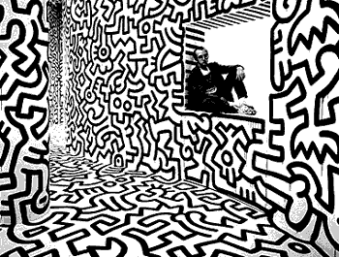
Haring designed his “Pop Shop” to be a work of art in itself”

Slide 33
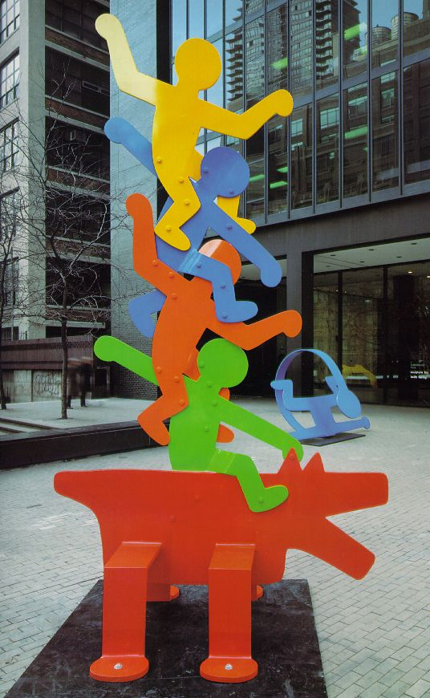
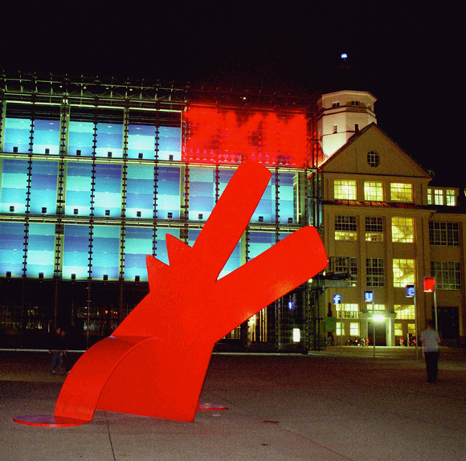
Haring did not limit himself to 2-dimensional work. He created many public sculptures. Some more than a couple stories high.

Slide 34
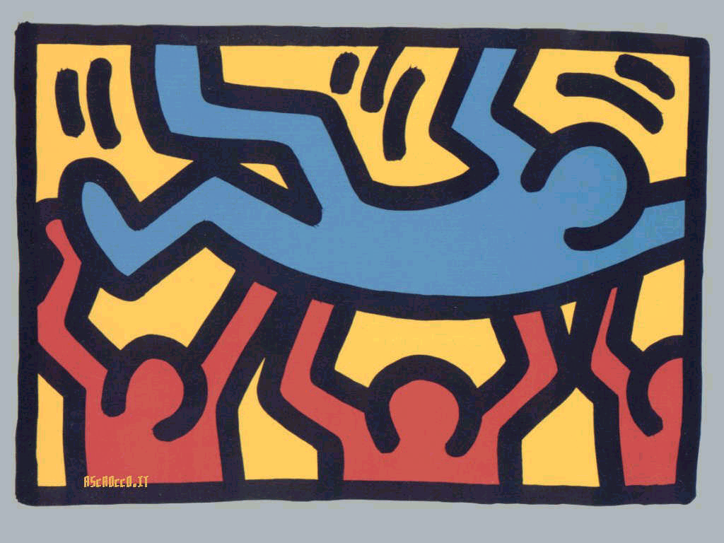

Slide 35
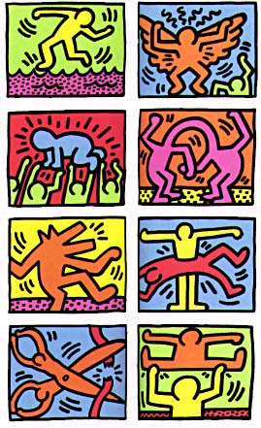
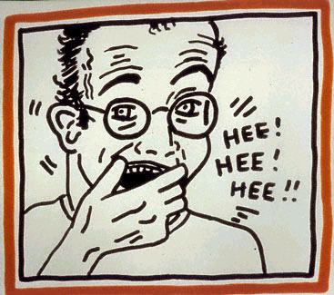

Slide 36
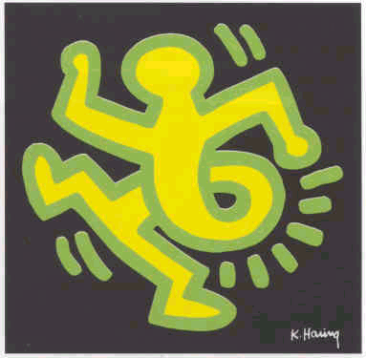

Slide 37
Keith Haring died in 1990 from aids.
He may have died young but his work remains some of the most influential art of today.

Slide 39
Untitled 1983, 180” x 276”

