Slide 1
Trimley ST. MARTIN
Religious Education Policy
Trimley St Martin Primary School
Mrs Thompson– RE Lead
Published June 2023

Slide 2
Religious Education
At Trimley St Martin we have the power to enable all children to gain an understanding into different religions and worldviews
We have the power to enable all our children to build respect for other’s beliefs and to begin their own personal development through making individual personal links, through the use of questioning

Slide 3
Curriculum intent for RE
At Trimley St Martin the National Curriculum is used to underpin our school’s Religious Education Curriculum and planning. By learning about RE it enables our children to investigate and reflect on some of the most fundamental questions asked by people.
At Trimley St Martin Primary School our aim is to develop the children’s knowledge and understanding of the major world faiths including addressing fundamental questions, concerning the meaning of life.

Slide 4
‘enables all pupils to gain an understanding in to
different religions and worldviews’
Support will be given to those with special educational needs and/or disabilities (SEND) so that all children can access the full RE Curriculum. We will assess the needs of each pupil and support through group or individual work, to secure the knowledge they need to continue to access the Religious Education content.

Slide 5
Implementation
At the heart of our implementation of RE lies the National Curriculum and
at Trimley St Martin Primary school we ensure that progression is planned into our scheme of work so that it offers an increasing challenge to the children as they move through the school.
We carry out the curriculum planning in three phases (long term, medium term and short term) Our long term plan outline the topic to be studied in each term, by each year group. RE is mostly taught as a timetabled subject, but links are made with other areas of the curriculum when appropriate.
As a school we use The Emmanuel Project written by The Church of England Diocese of St Edmundsbury and Ipswich, which allows us to focus on a BIG Question for each of our units. Our planning especially allows for making links from previous years and recapping learning.

Slide 6
What the Law says on Religious Education
Parents have a legal right to withdraw children from RE. They do not have to provide a reason and schools must comply. Teachers may withdraw from teaching RE, with certain exceptions in church schools.
Parents are advised of the current provision for RE and Collective Worship provided on the school website as required by law. They are asked to contact the Head Teacher if they wish to exercise the right to withdraw and discuss their requirements. Hopefully a satisfactory understanding will be reached and permit any arrangements for alternative RE or supervision to be made.

Slide 7
Cross-curricular links
The Emmanuel project includes many cross-curricular links.
Many are made through the use of Drama, Art, Design technology and English reading and writing.
At TSM we are finding ways to allow our children to focus on the Big Question in many different ways.

Slide 8
Impact
Our RE planning and teaching will allow pupils to become increasingly aware of other’s worldviews and how these may change over time.
By following the we are allowing time for our pupils to develop their own thoughts and beliefs.
Developing an understanding and respect for diversity will help our pupils to grow and develop for the future.

Slide 9
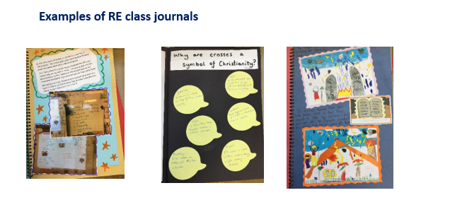
Impact

Slide 10
How can we use the Learning Gems in RE?
Look back on and reflect own and other people's work.
Reflect on questioning
Work independently to record our work in numerous ways.
Explore the adventurous ways to express our learning within a group
Work over time to gain knowledge and understanding of other’s beliefs
Work with others to express understanding.
Focus and concentrate on questioning tasks.
Work creatively within a group to express meaning and understanding

Slide 11
Assessment
Ongoing formative assessment-
Each RE unit has assessment opportunities for us to monitor the progress of our pupils.
At TSM , we use our Teacher Tasks and Assessments sheets to assess learning and understanding on-going through our unit.
End of unit assessments –
At the end of the unit we use The Emmanuel Project Taxonomy
Record of Assessment-
The use of target tracker to
record our data

Slide 12
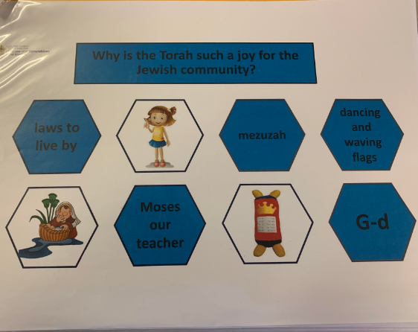
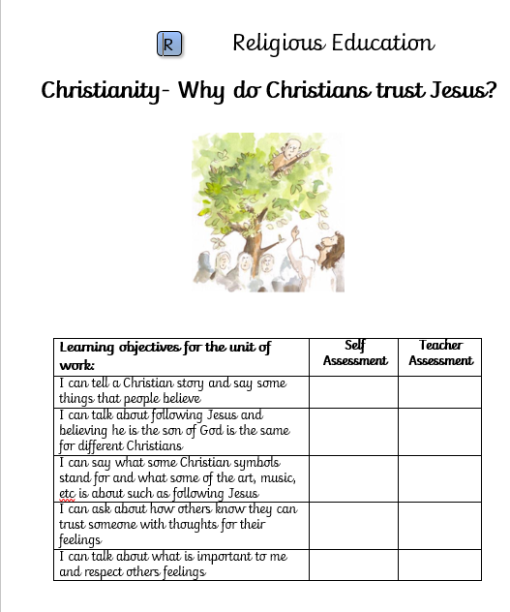
Assessment
Using end of unit The Emmanuel Project Taxonomy
Teacher assessment
Progress recorded on Target Tracker

Slide 13
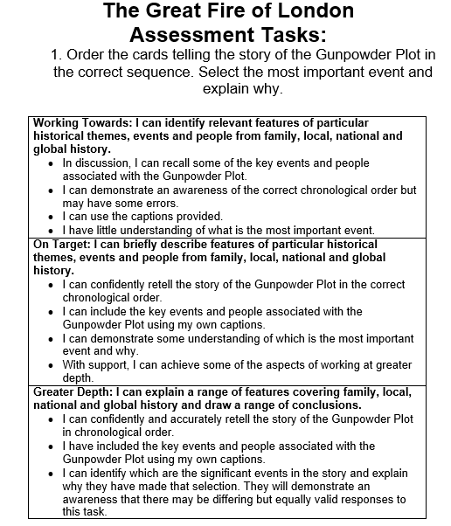
Assessment
Knowledge organisers
‘The Big Finish’
Progress recorded on Target Tracker

