Slide 1
Trimley St Martin Primary School
Meet the Teacher
PLEASE SIGN THE REGISTER
Miss Thurlow
Lincoln Class (Year 2)

Slide 2
What’s this meeting all about?
Meet the teacher
Assessing without levels
Homework
P.E.
Timetable

Slide 3
About me…
  2nd Year teaching Year 2 at Trimley St Martin Primary School.
  Understand the huge pressure placed on children by the new curriculum.

Slide 4
Changes for Sept 16
Interim Headteacher- Mrs Ross
The challenge of finding an outstanding new head
New Maths and Spelling homework
Greater emphasis on school and home learning- working with parents/carers for successful learning

Slide 5

Home School Agreement

Slide 6
PLEASE SIGN BEFORE YOU LEAVE…
Home School Agreement

Slide 7
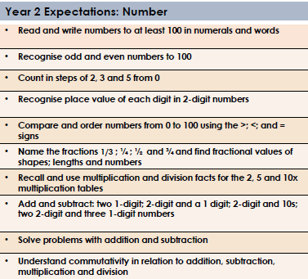

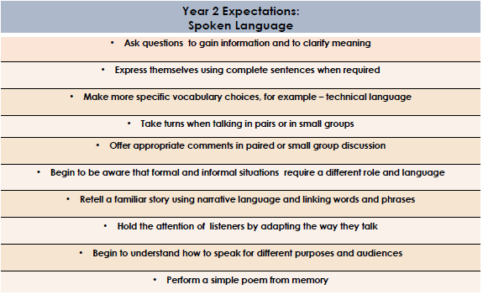

Maths
End of Year 2 Expectations
This booklet includes the end of year 2 expectations for children in our school based on the new National Curriculum. These are the minimum requirements your child must meet in order to be graded as working at ‘National Expectation.’
All the objectives will be worked on throughout the year and will be the focus of direct teaching. Any extra support you can provide in helping your children to achieve these is greatly valued.
If you have any queries regarding the content of this booklet or want support in knowing how best to help your child please talk to your child’s teacher.
Spoken Language

Slide 8

Reading
Writing

Slide 9
Assessing Without Levels

Slide 10
How well is my child doing?
Parents Evening OCTOBER
Parents Evening FEBRUARY
Open Night / School Reports JULY

Slide 11
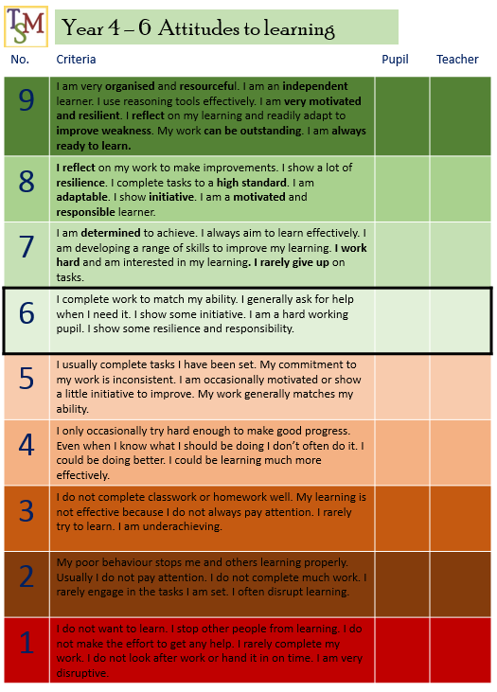
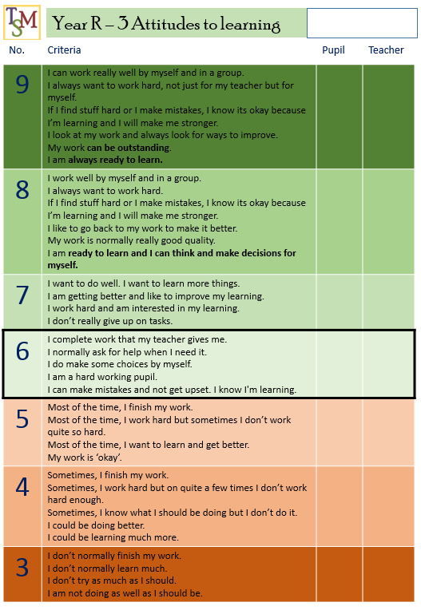
Attitude to learning FAQs
Why might there be a difference between the teacher’s and my child’s grading?
[e.g Teacher grade higher than pupils grade]
– This occurs generally with children who lack confidence. The child is unable to identify how good they are or the skills they have.
Or pupil doesn’t fully understand the phrases included in the report
[e.g Teachers grade lower than pupils grade]
– This occurs generally with children who are overly confident. They may feel they are working hard when in fact their teacher may be aware that they can do so much better!
Or pupil doesn’t fully understand the phrases included in the report.
I don’t agree with the teachers grading! My child is a good learner at home!
- This judgment is based on what the teachers see in school. If your child does show good learning skills at home, then it may be worth reminding your child that they need to show this in school.
What score should my child be at?
- As a school we are aiming for at least stage 6. This is the first time we have done this and so we have a number of children in the 3,4 and 5 section. Over time we hope to see this improve as we work with the children and help them to understand the importance of being a good learner. Children will also start to understand what is meant by each of the levels more and in turn be able to make a more accurate judgment of their own learning.
Attitude to learning

Slide 12
Why?
-To highlight to children that it will be their Attitude to Learning that will enable them to be successful in life, regardless of where they are academically.
-A chance for those children who often struggle to receive recognition for commitment and dedication towards their leanring.
-A kick up the bum for those who may be coasting… they’ll soon be catching you!
Attitude to learning

Slide 13
Is my child green or amber on the progress graphs?
Despite your child not making as much progress as they should. They have the right attitude to succeed. With support provided from school and regular contact between teachers and parents it is likely that your child will catch up to where they need to be.
Yes
No
Your child is making progress in class and with an excellent attitude to learning this success is likely to continue and help ensure they leave primary school well prepared for the next stage of their education
Is their Attitude to learning score 6 or above?
Is their Attitude to learning score 6 or above?
Yes
Yes
No
No
Your child is currently making progress in class but if they do not apply themselves as much as possible they are at risk of falling behind and not making enough progress.
Your child is not making the expected progress in school. This is not helped by their attitude towards their learning. They need to apply themselves more in lessons and make sure they are working as hard as they can in school.
If your child can improve their attitude to learning, work hard in lessons and work hard in their booster groups they are more likely to catch up or at least make progress towards catching up.

Slide 14
Don’t panic!
BOOSTERS

Slide 15
HOMEWORK
  Reading 5x per week
  Maths homework
  Handed in to school >> Thursday
  Work marked and sent home >> Friday
  Spelling / punctuation / grammar homework
  Handed in to school >> Thursday
  Work marked and sent home >> Friday

Slide 16
(1) Reading 5x a week
New Banded books
Letters will sent home by Mrs Matthews for not completing the minimum 3x per week.

Slide 17
(2) Maths HW
Should be done independently
Meant to be a chance for children to recap, revisit basic skills
Further challenge >> sideways not up
Letters sent home by Mrs MacFarlane if not completed.

Slide 18
SPAG (3) –
Should be done independently
Meant to be a chance for children to recap, revisit basic skills
Further challenge >> sideways not up

Slide 19
Volunteers
Sign up to what you can offer…
DBS check will be needed
We will try to cater for all offers… however, there are some occasions / lessons where too many adults may be a hinderance.

Slide 20
Class: __________________
Leave name
Contact number
Volunteers
 | Mon | Tue | Wed | Thu | Fri
AM
PM
Sign up to what you can offer…
DBS check will be needed

Slide 21
Times Table Challenge
Continues again this year.
Pupils will work towards the year group expectation.
This may require some repeats in knowledge and x tables covered. This is to check the x tables have been retained and are embedded. (If too easy, within 3 weeks pupils can reach the platinum and blue topaz certificates.
AIM – All pupils to achieve at least silver (National Expectation)

Slide 22
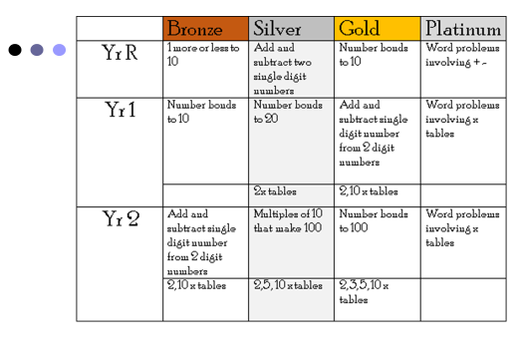

Slide 23
The Blue Topaz!
In order to achieve Blue Topaz children must have completed Bronze, Silver, Gold and Platinum then:
  Support a child from their class to achieve a bronze / silver certificate by helping them practice, showing them ways of remembering and recalling their timetables under pressure as well as remembering particular patterns with learning the times tables.

Slide 24
Pick Up Arrangements
.

Slide 25
Uniform
Children will be given spare uniform if they arrive at school without the correct uniform on.
2 chances only to forget P.E. kit and swim kit.
Letter will go home regarding incorrect uniform and incorrect P.E. kit

Slide 26
Late Collection
Children not picked up by 3:45pm will be taken to After School Club.
Parents will be charged when they arrive to pick up their children.

Slide 27
Attendance & Holidays
If a holiday request is unauthorised it is an instant fine
All schools in the Felixstowe cluster are following the same process
Felixstowe Academy may be different as it is an academy.

Slide 28
Getting to speak to Teachers
After school is best
Messages can be given to the adult who opens the gate.
If the adult thinks the message requires a face to face chat with the class teacher the adult will let you into the building. (However - You may need to wait until 9:05am)

Slide 29
Who do I speak to about…?
BULLYING
1st >> Miss Thurlow
2nd >> Senior Leader (Mrs MacFarlane, Mrs Matthews)
3rd >> Mrs Ross
SEN
1st >> Miss Thurlow
2nd >> Mrs Lawrence
3rd >> Mrs Ross

Slide 30
Who do I speak to about…?
CHILD’S LEARNING & PROGRESS
1st >> Miss Thurlow
2nd >> Senior Leaders(Mrs MacFarlane or Mrs Matthews)
3rd >> Mrs Ross
CHILD PROTECTION
1st >> Mrs Ross or Mrs Matthews
2nd >> Mrs Mann (Governor) or Mr Kemp (Chair of Governors)

Slide 31
Child Protection
Report all child protection concerns to an adult >> preferably those listed on the following page.
However small the information may be, we may already have other information about the child.

Slide 32
Safeguarding children is everybody's business!
Designated Safeguarding Lead (DSL)
Mrs Samantha Ross
Acting Head teacher
Deputy Designated Safeguarding Lead (DDSL)
Mrs Joanna Matthews
Senior Leader
Governors Responsible for Safeguarding
Mr David Kemp
Chair of Governors
It is your DUTY to report any concerns that you have about a child.
Mrs Alicia Mann
Safeguarding Governor

Slide 33
Safeguarding children is everybody's business!
We all share responsibility for safeguarding and promoting the welfare of children and young people, whether as a parent or family member, a friend or neighbour, an employer, or as a paid or voluntary worker.
All members of the Trimley St Martin community can help to safeguard and promote the welfare of children and young people if we are all mindful of the children’s needs and willing and able to act if we have concerns.
Definition of safeguarding
In its simplest terms ' safeguarding' can be defined as 'keeping children safe from harm, such as illness, abuse or injury'.
At Trimley St Martin, we are committed to ensuring that;
Everybody working with children, young people and their families take all reasonable measures to ensure that the risks of harm to children's welfare are minimised, and
When there are concerns about children and young people's welfare, we take all appropriate actions to address those concerns, working to agreed local policies and procedures in full partnership with other local agencies.

Slide 34
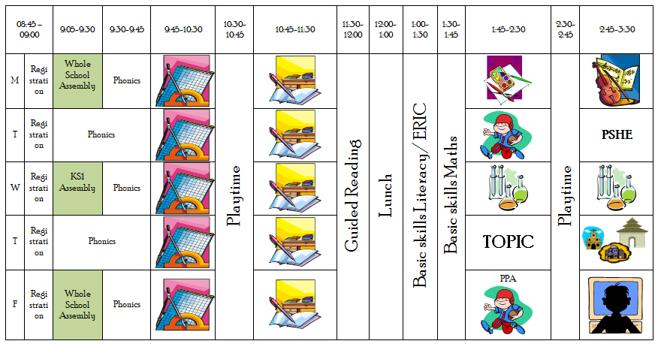
Timetable

Slide 35
P.E
P.E. Kit needed in school on…
(1) Tuesday and Fridays – trainers, white t-shirt, royal blue shorts (in addition they may need a navy, black or royal blue tracksuit for cold weather)

Slide 36
?
Any questions?

