Slide 1
When I Grow Up….

Slide 2
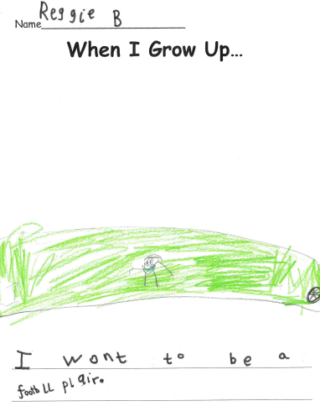
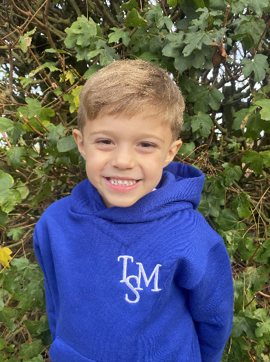
When I Grow Up…
Reggie B

Slide 3
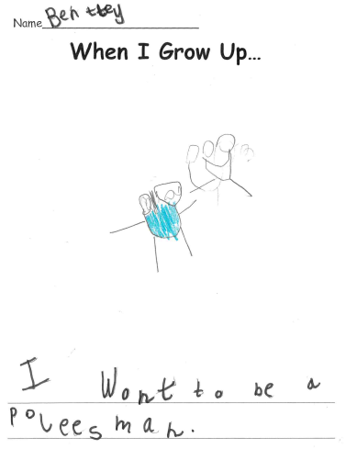
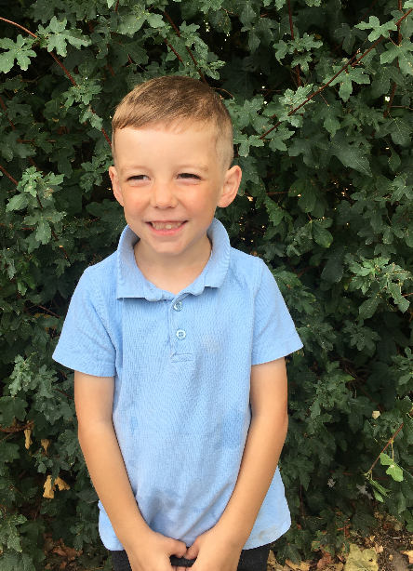
When I Grow Up…
Bentley

Slide 4
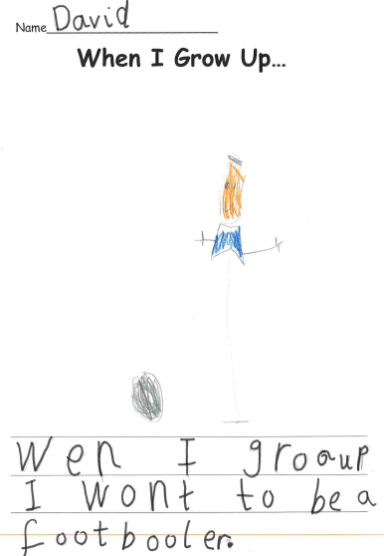
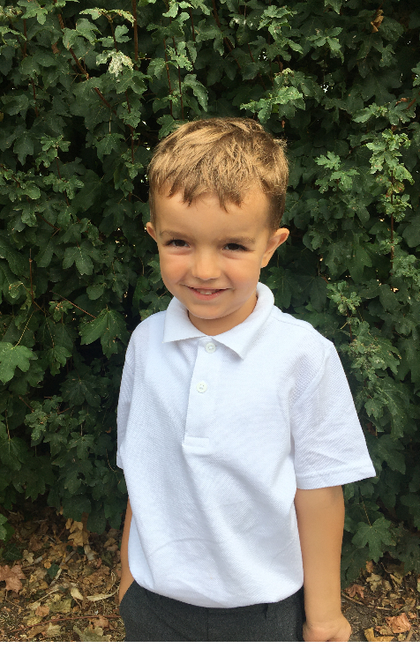
When I Grow Up…
David

Slide 5
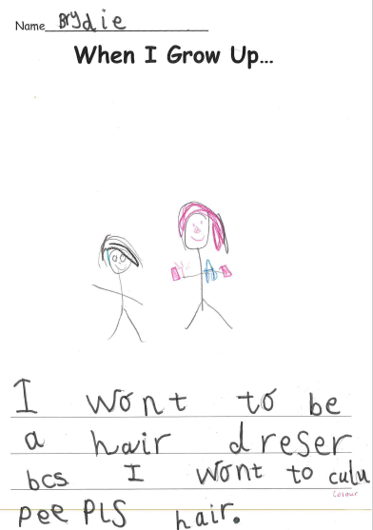
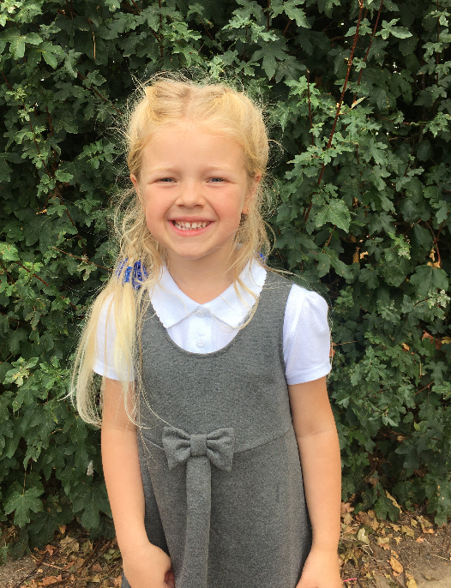
When I Grow Up…
Brydie

Slide 6
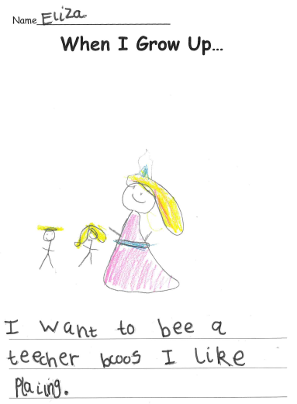
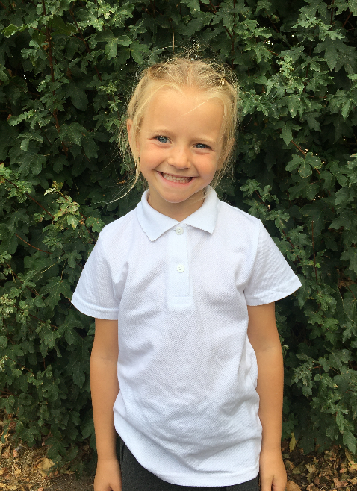
When I Grow Up…
Eliza

Slide 7
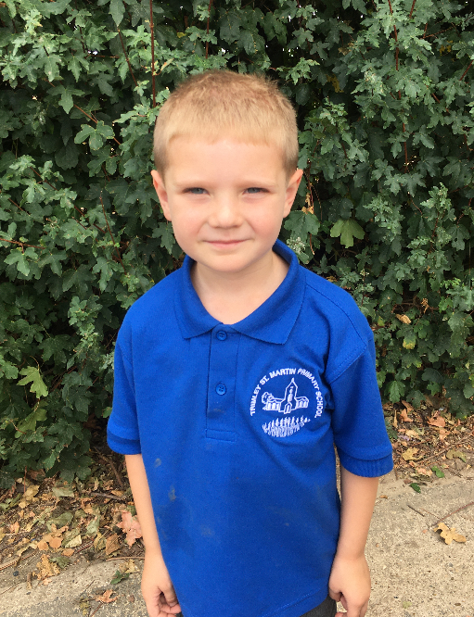
When I Grow Up…
Jack

Slide 8
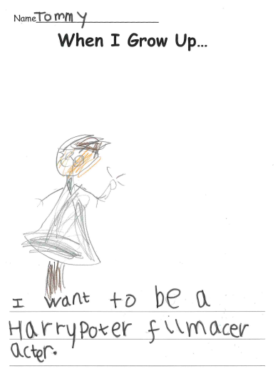
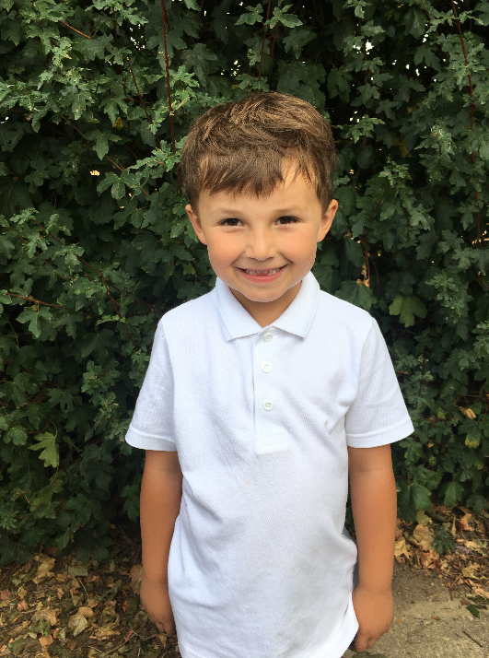
When I Grow Up…
Tommy

Slide 9
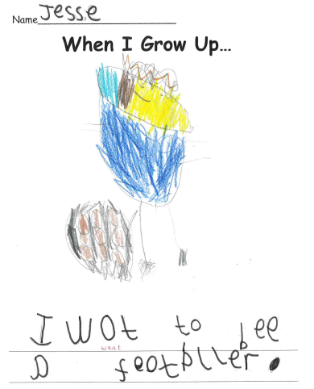
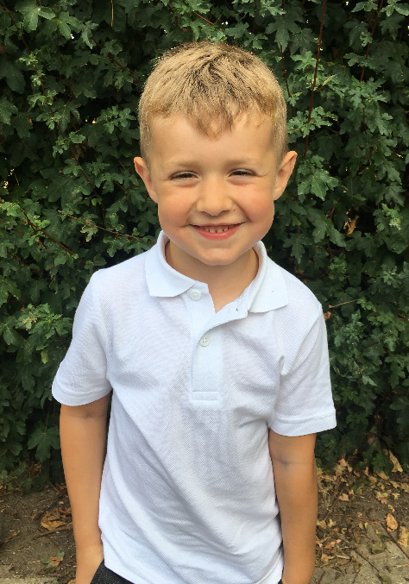
When I Grow Up…
Jesse

Slide 10
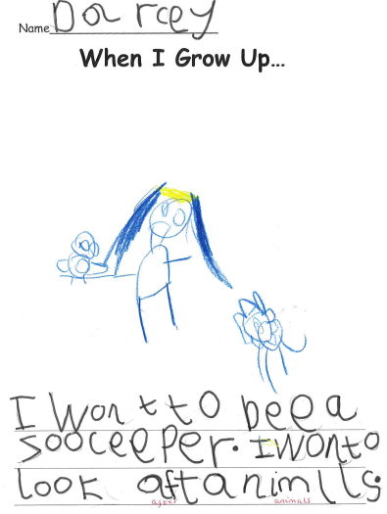
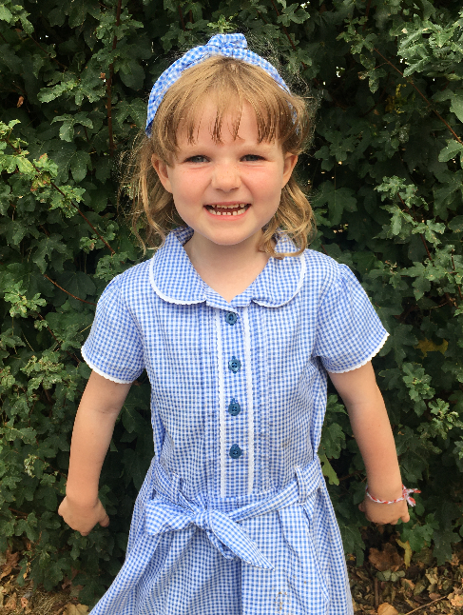
When I Grow Up…
Darcey

Slide 11
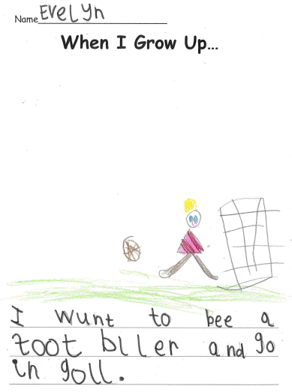
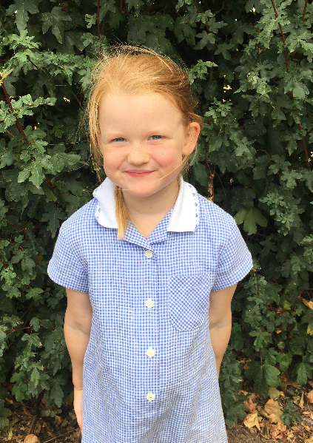
When I Grow Up…
Evelyn

Slide 12
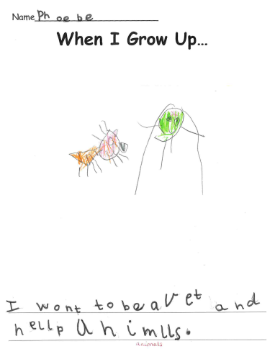
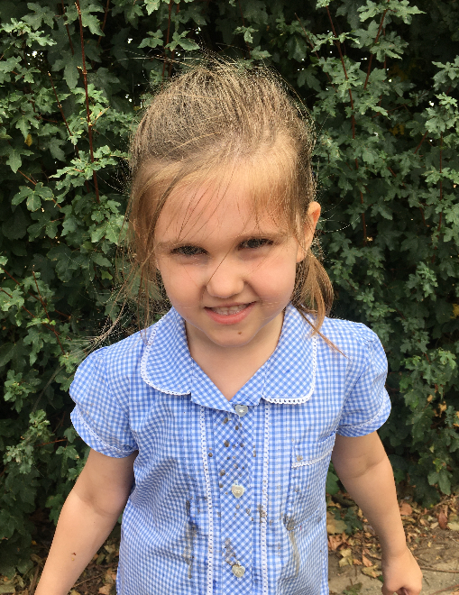
When I Grow Up…
Phoebe

Slide 13
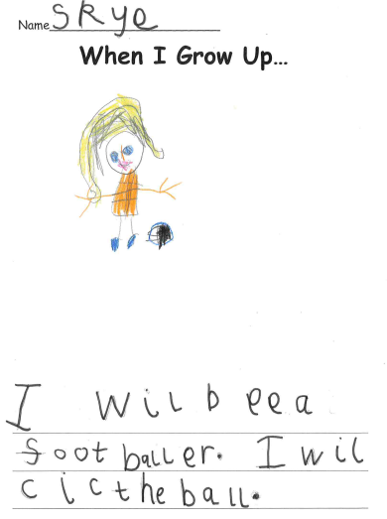
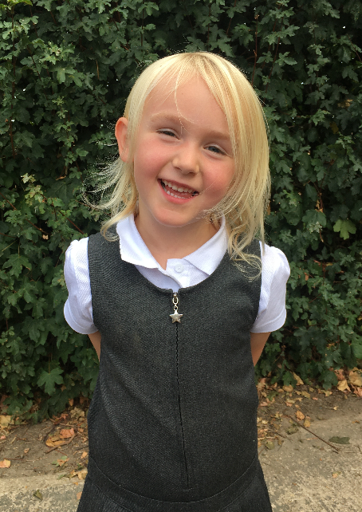
When I Grow Up…
Skye

Slide 14
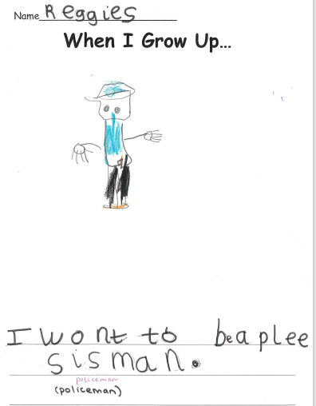
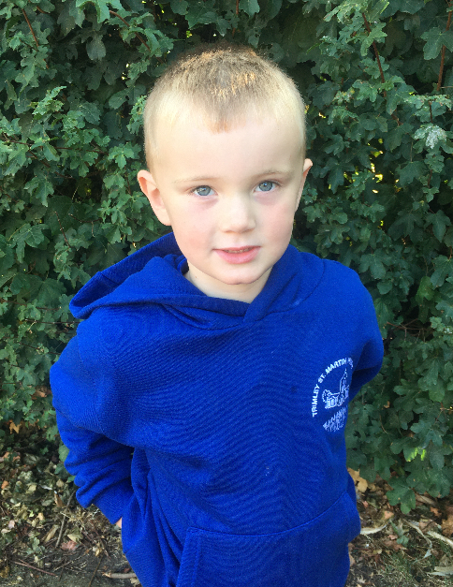
When I Grow Up…
Reggie S

Slide 15
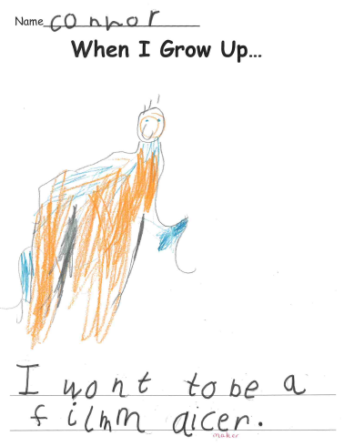
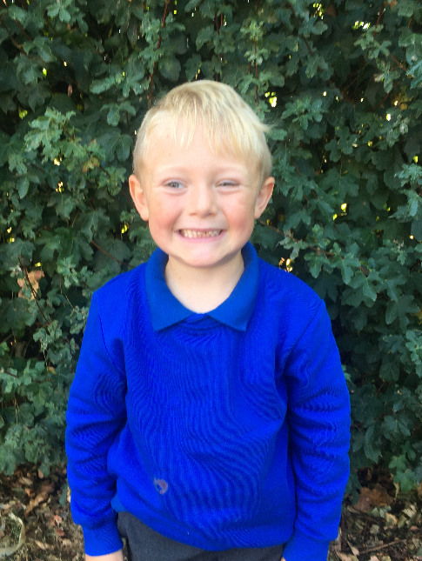
When I Grow Up…
Connor

Slide 16
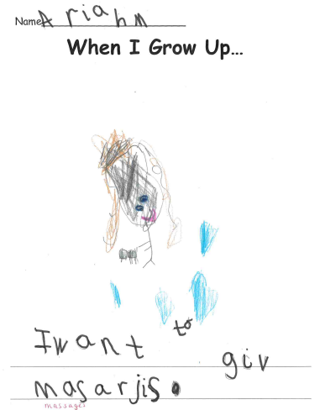
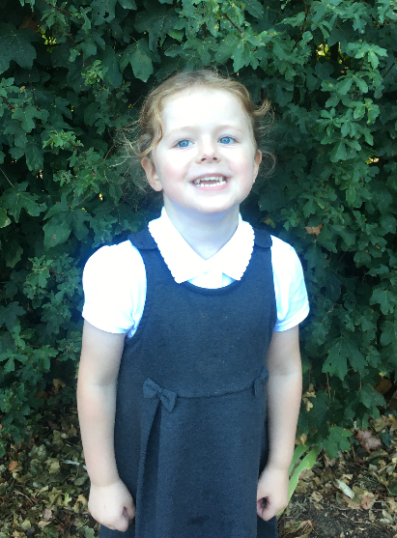
When I Grow Up…
Ariah M

Slide 17
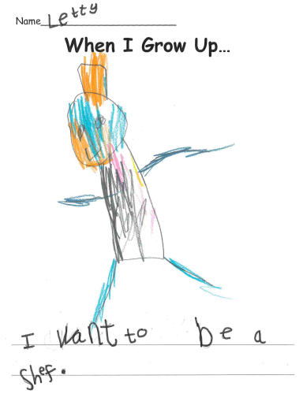
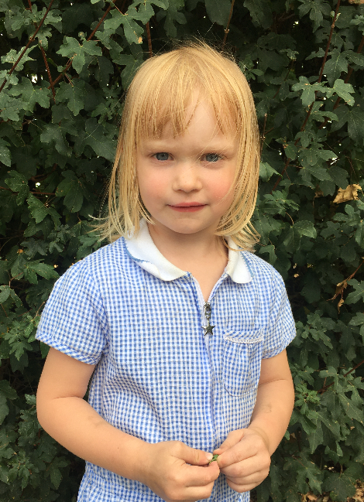
When I Grow Up…
Letty

Slide 18
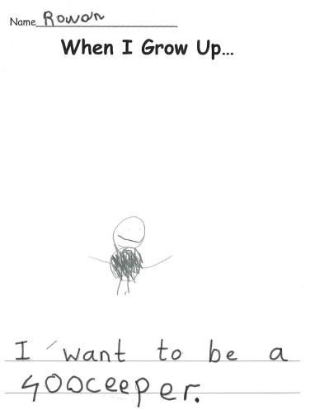
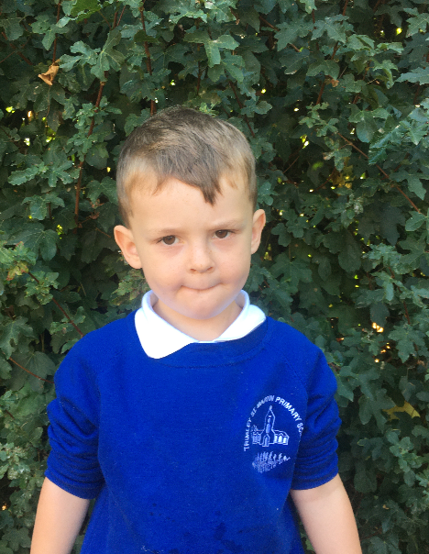
When I Grow Up…
Rowan

Slide 19
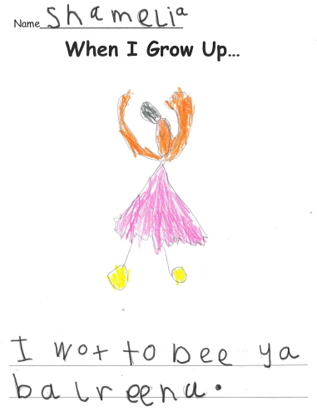
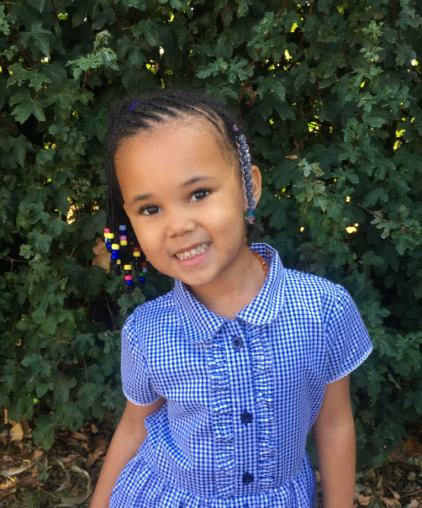
When I Grow Up…
Shamelia

Slide 20
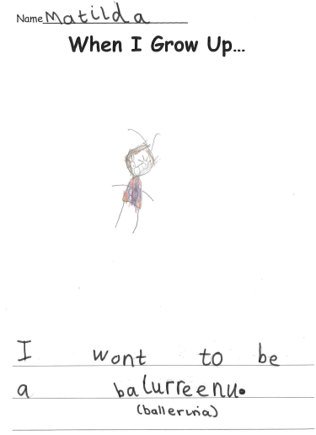
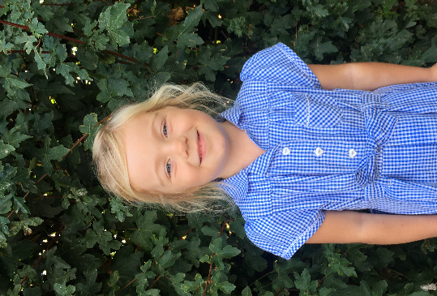
When I Grow Up…
Matilda

Slide 21
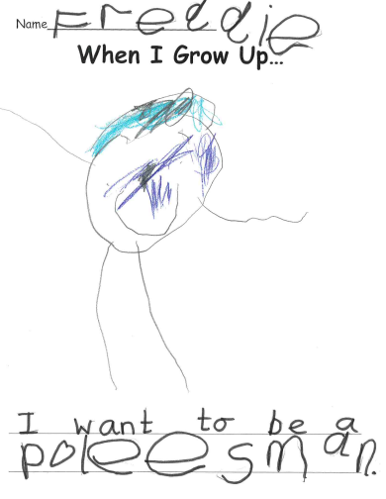
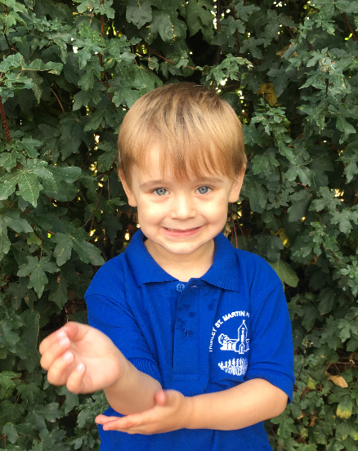
When I Grow Up…
Freddie

Slide 22
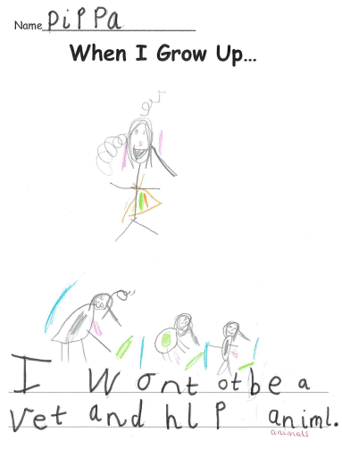
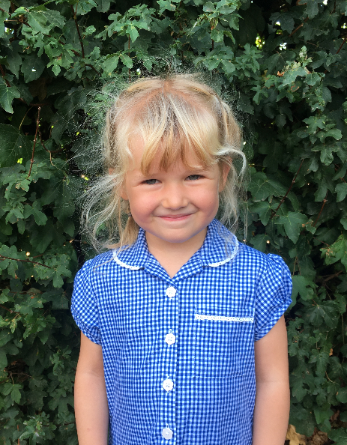
When I Grow Up…
Pippa

Slide 23
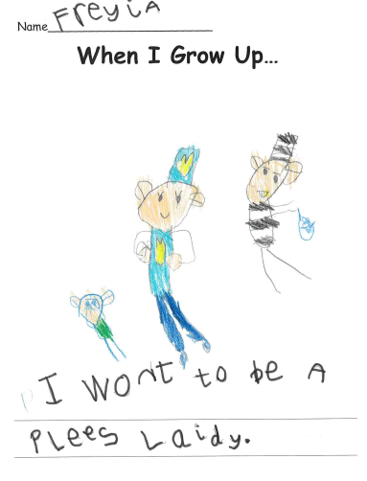
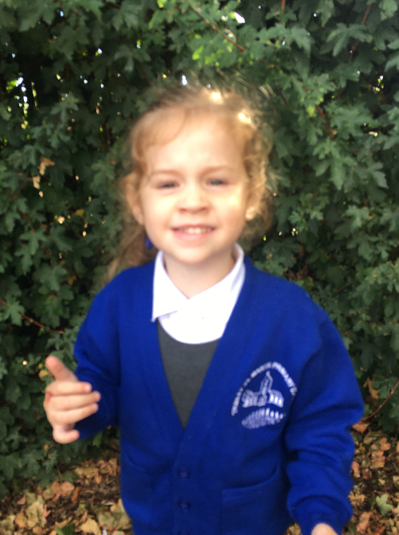
When I Grow Up…
Freyja

Slide 24
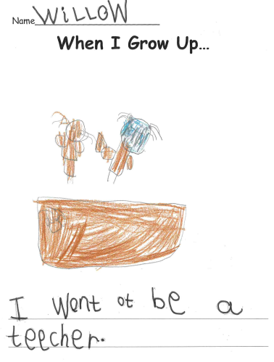
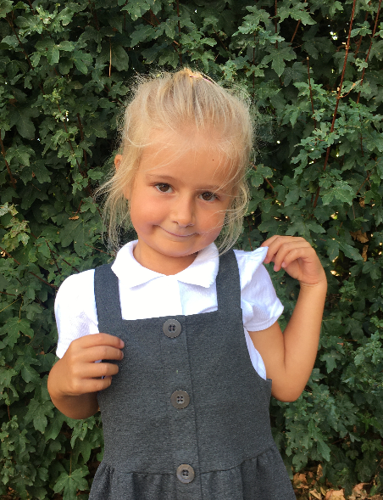
When I Grow Up…
Willow

Slide 25
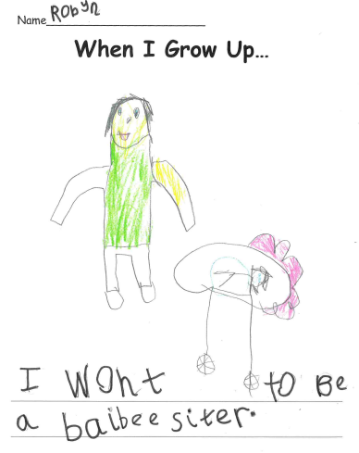
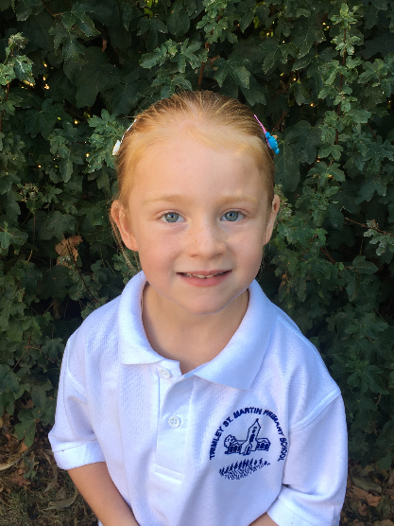
When I Grow Up…
Robyh

Slide 26
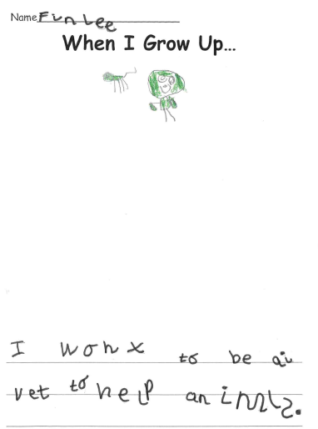
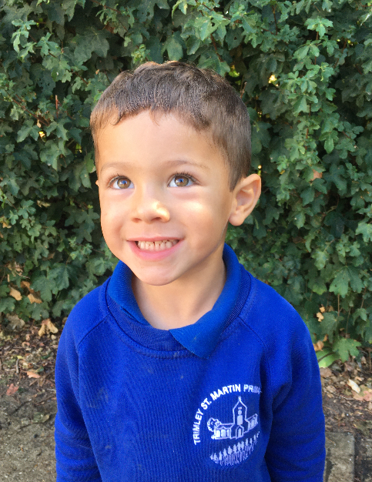
When I Grow Up…
Finlee

Slide 27
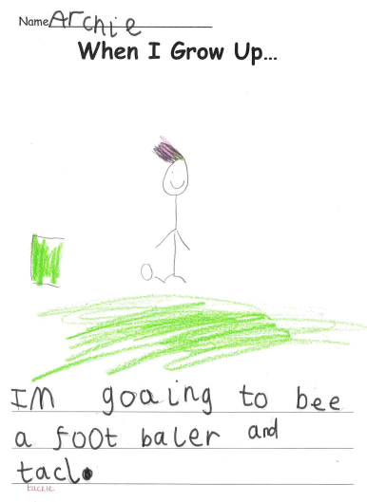
When I Grow Up…
Archie

Slide 28
When I Grow Up…
Ariah V

Slide 29
We are all so proud of you and can’t wait to see what wonderful things you do when you grow up!

Slide 30
We are all so proud of you and can’t wait to see what wonderful things you do when you grow up!

Slide 31
We are all so proud of you and can’t wait to see what wonderful things you do when you grow up!

Slide 32
We are all so proud of you and can’t wait to see what wonderful things you do when you grow up!

Slide 33
We are all so proud of you and can’t wait to see what wonderful things you do when you grow up!

Slide 34
We are all so proud of you and can’t wait to see what wonderful things you do when you grow up!

