Slide 1
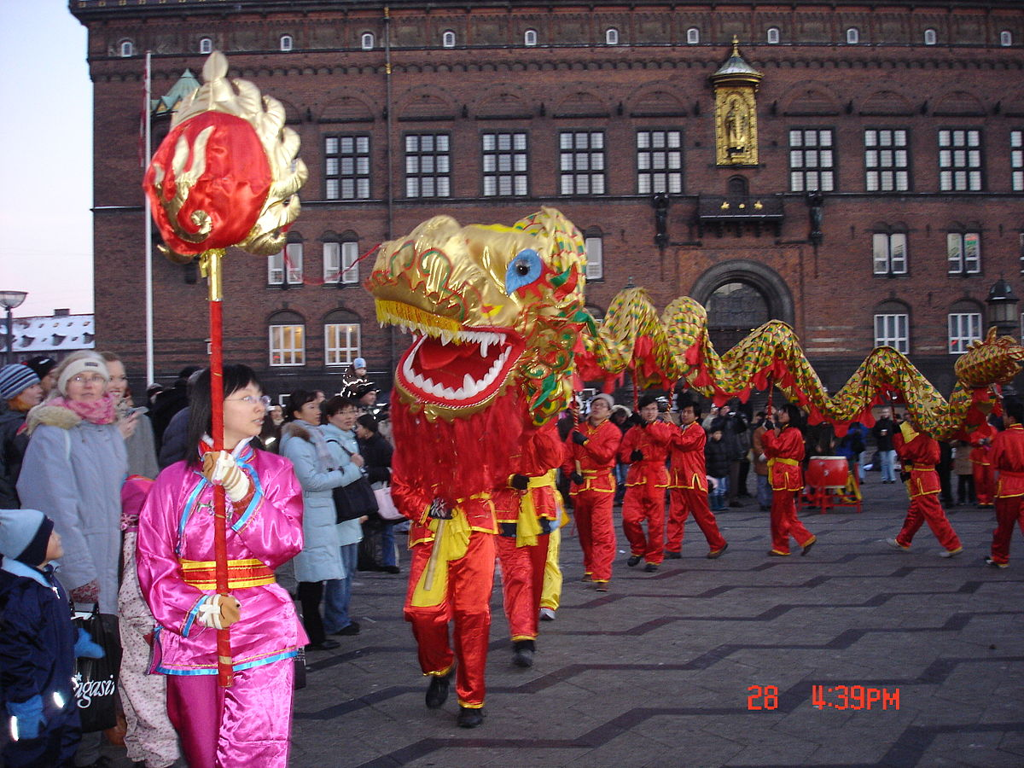
YR Topic – Chinese New Year
PSED Being Kind https://www.bbc.co.uk/iplayer/episode/m00023c7/treasure-champs-series-2-1-kindness Talk about different ways to be kind and to help others Can you make your own kindness stone! | Play Provision Ideas Traditional Chinese Games https://www.activityvillage.co.uk/traditional-chinese-games | Communication and Language Attention & listening Chinese Whispers/DIY Telephone Game 3 on the link https://famly.co/blog/inspiration/10-simple-communication-and-language-activities/ | Play Provision Ideas How many of these can you do throughout the week? http://www.helpmykidlearn.ie/activities/5-7 http://www.helpmykidlearn.ie/activities/3-4
Physical Development Chinese Dragon Dancing Join Jamie and Hannah as they find out about the Chinese lion dance. https://www.bbc.co.uk/cbeebies/watch/lets-go-club-chinese-lion-dance Watch our Chinese dragon and lion dances on our class page Did you enjoy watching the dancers? Which dance did you like the most? What musical instruments could you hear? How could we make your own Chinese lion or dragon? Send us your video we would love to see it | Communication and Language Reading Comprehension Read your story books on Rising Stars and complete the quizzes… The instruction game Call out instructions e.g. “Go and get a cup, Go and get a paintbrush and take off your shoe’’. Follow the instructions. Start with one instruction and add one more each time to the same sentence. How many can you do? | Physical Development Take part in the Multi skills challenge and record your scores for the week. Cooking Using our recipe book or one found on line cook and try some Chinese foods | PSED RE- Helping Hands Watch/share the story- Helping Hands https://www.youtube.com/watch?v=g98i5L1Z680 What can you do to give a helping hand around the house? Draw around your hand and see if you can add five different ways you have lent a helping hand this week
Expressive Arts and Design Chinese Fire Crackers https://www.china-family-adventure.com/chinese-new-year-firecrackers.html#.VMF9BcYVJdE Chinese Lanterns https://www.origami-resource-center.com/chinese-lantern.html | Understanding the World Safer Internet Day- 9th February Read through our “Smartie the Penguin” PowerPoint and talk about what you need to do to keep yourself and others safe online and when using electronic devices such as mobiles, laptops and tablets. | Understanding the World Science Watch the film to find out how to defeat gravity with a bottle rocket. https://www.bbc.co.uk/teach/terrific-scientific/KS2/zr63d6f Make your own rocket and see it fly (See instruction) | Expressive Arts and Design Watch the Story of Nian https://www.youtube.com/watch?v=P1AKwg7Ng2s Make your own Chinese dragon https://www.redtedart.com/chinese-new-year-craft-dragon-puppet-free-printable/
You could record your discussions, make notes or take photos and add it to Tapestry. Some work will be required to be completed in an exercise book.

Slide 2
Phonics Start your daily phonics with our phonics song: https://www.youtube.com/watch?v=48uf9I6P2xQ
We are learning sounds ai Practise saying the sound (digraph) for ai Geraldine the Giraffe ai https://www.youtube.com/watch?v=LnXaN-CvR9s Try and sound out and write these words: wait, hail, pain, aim, sail, main, tail, rain, bait. Hold up sentence written on card or a piece of paper – encourage them to blend if they get stuck. I will wait for a taxi. The cat has a long tail. I sang a song in the rain. | We are learning sounds ee Practise saying the sound (digraph) for ee Geraldine the Giraffe ee https://www.youtube.com/watch?v=qfM7Hz7US0U Play Picnic on Pluto with the phase 3 letters ee: https://www.phonicsplay.co.uk/resources Hold up sentence written on card or a piece of paper – encourage them to blend if they get stuck. He can see his big feet. I feel sad in the rain. A cat can meet a rat. | We are learning to read the tricky words was, my Practise s, a, t, p, i, n, m, d, g, o, c, k, ck, e, u, r, h, b, f, f, l, ll, ss, j, v, w, xy, z, qu, sh, ch, th, ng, ai, ee. by playing the fly squatter game (see instructions) Practise reading the words was and my over and over Hold up sentence written on card or a piece of paper – encourage them to blend if they get stuck. My rat was mad at the vet. The rain was a pain. I need to feed my cat and my dog. | We are learning sounds: igh Practise saying the sound (trigraph) for igh Geraldine the Giraffe igh https://www.youtube.com/watch?v=OYCR2RZ4ZYY Try and sound out and write these words: high, light, night, fight, sigh, tonight, might, tight. Hold up sentence written on card or a piece of paper – encourage them to blend if they get stuck. Is the answer yes or no? Can a fox sail? Can a rat feel pain? Will it rain tonight? Will a chick cheep? | We are learning sounds: oa Practise saying the sound (digraph) for oa Geraldine the Giraffe oa https://www.youtube.com/watch?v=KCJyHN0IFE8 Try and sound out and write these words: goat, foal, cat, dog, rat, fox, rat, sheep, vet. Can you write these sentences? Can the vet see my ...? And add in the name of an animal of choice from the list of animals above.
This week our Literacy activities are based around The Chinese New Year- we will find out, read about, draw about and write about this exciting Chinese festival.
Find out!! https://www.youtube.com/watch?v=c8ssHXZ9_qU Listen to the story of how the first ever Chinese New Year was named https://www.youtube.com/watch?v=eVClAj8q_lY This year is the Year of the Ox When were you born? 2015 – Goat 2016 – Monkey Write about!! If you were to have a Chinese New Year party what food would you have? Write out a list of your favourite foods. Remember lists are written one under the other. | Read about!! Read the Chinese New Year Story (Use the Chinese New Year ebook) What animals are you on the Chinese calendar? Choose the one you like best Draw it!! Draw your favourite character Write it!! Label/write a sentence about your animal | Find out!! https://www.youtube.com/watch?v=1cRMRp9-Z08 Write it!! Use the link to find out how to write your name and family names in Chinese.. https://chinese.gratis/names/ | Act it! Can you find toys or objects to use to retell the story of the Chinese New Year? Use the language from your maths too… first, second, before, after, last. Video your story to share. | Write it!! Instructions Write about something you have made this week

Slide 3
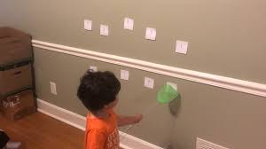
Maths Start your daily maths with number songs for example: ten green bottles, 1, 2 buckle my shoe
Days of the Week Join in with our days of the week song https://www.youtube.com/watch?v=8GKmCQOy88Y What day is it today? What day was it yesterday? What day will it be tomorrow? How many days until Sunday? How many days ago was it Monday? Write the days of the week on paper/use day cards- How fast can you order the days of the week starting from Sunday, Tuesday, Saturday? Record something you did, enjoyed, found out each day. (use diary or write the days Monday- Sunday on a new page in your book) Can you add labels or describe what you did? Complete over the week |  | Months of the Year Join in with our months of the year song https://www.youtube.com/watch?v=Fe9bnYRzFvk&list=PLV4susC4x15oEZ9AQUMEvPQxkh5j2q0uH&index=7&t=0s Rewatch the story of the Chinese New Year https://www.youtube.com/watch?v=P4WlzNrpUCs Talk about which animal came 1st, 2nd and last (Ordinal numbers) Using the ordinal numbers and pictures (or drawn out on paper) match and order the animals in the correct order using positional language too for example the ox came second after rat. | Counting forwards and backwards Count from 0-10 and 10-0… can you count forwards and backwards to 20, 30… how far can you get? Tangrams During the festival of Chinese New Year children play puzzles called tangrams. These are puzzles usually made up of seven triangles. Using seven cut out triangles or the Tangram sheets can you make some of the animals from Chinese New Year story? | Flashcard Challenge Use the cards/write out on paper: start with 0-10. Shuffle cards and hold up randomly- what's the number? How fast can you name all numbers? Extend with numbers to 20, 30 etc. Dominoes During the festival of Chinese New Year children play many different domino games Have a go of this one (You will need lolly sticks with dots or drawn/printed dominoes. https://www.activityvillage.co.uk/tiu-u-fishing | Ordering forwards and backwards Use the cards/write out on paper and order 0-10 and 10-0… can you order forwards and backwards to 20, 30… how far can you get? Challenge yourself to some ordering and sequencing games https://www.topmarks.co.uk/ordering-and-sequencing/chinese-dragon-ordering Can you sequence even numbers, in 2’s? What is the highest number you can order?
Additional links for Phonics/Literacy and Maths
Alphablocks: ai https://www.youtube.com/watch?v=t_KYgujWQSo | Alphablocks: ee https://www.youtube.com/watch?v=t_KYgujWQSo Ordinal Numbers https://www.youtube.com/watch?v=BaO1E21SpkI |  | The fly squatter game Write out/print out the sounds to practise Set up the game by placing the cards out on a table and well spaced out. The adult calls out one sound at a time. The child must find the sound among the cards on the table and then “splat” the word with their fly swatter or hand while repeating the sound. | Alphablocks: igh https://www.youtube.com/watch?v=nGBbRgihRgo | Alphablocks: oa https://www.youtube.com/watch?v=4PpcG5UMSn8

